Slide 1
Logistic Regression and SVM Week3

Slide 2
Fitting your data

Slide 3
Fitting your data
If X>x1 then Y=1
If X<x1 then Y=0
0.5
x1

Slide 4
Fitting your data
If X>x1 then Y=1
If X<x1 then Y=0
0.5
x1
What will happen if you added a point to the right?

Slide 5
Fitting your data
If X>x1 then Y=1
If X<x1 then Y=0
0.5
x1
x2

Slide 6
Plot the following function

Slide 7
Fitting your data
Logistic Regression returns the probability that a certain data point belongs to a class Y given some features and the model
P(Y=1|x,m). For example, the probability that patient has cancer given that he had a history in his family and given the model parameters.

Slide 8
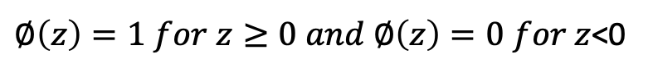
Plot the following function
$∅\left(z\right)=1 for z≥0 and ∅\left(z\right)=0 for z$<0

Slide 9
How this would look in 2D data?
3
2
1
1
2
3

Slide 10
How this would look in 2D data?
x2
3
2
1
1
2
3
x1

Slide 11
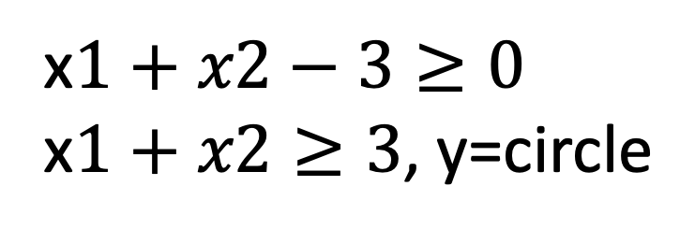
How this would look in 2D data?
x2
3
x$1+x2−3≥0$
x$1+x2≥3$, y=circle
2
1
1
2
3
x1

Slide 12
How this would look in 2D data?
x2
3
x$1+x2−3≥0$
x$1+x2≥3$, y=circle
2
Decision Boundary
1
1
2
3
x1

Slide 13
What should happen in this case? Remember, in linear regression we could also fit polynomial.

Slide 14
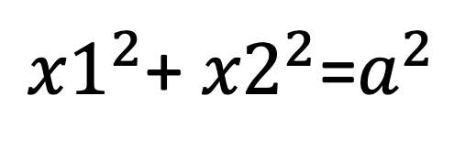
What should happen in this case? Remember, in linear regression we could also fit polynomial.
${x1}^{2}$+ ${x2}^{2}$=$a^{2}$

Slide 15
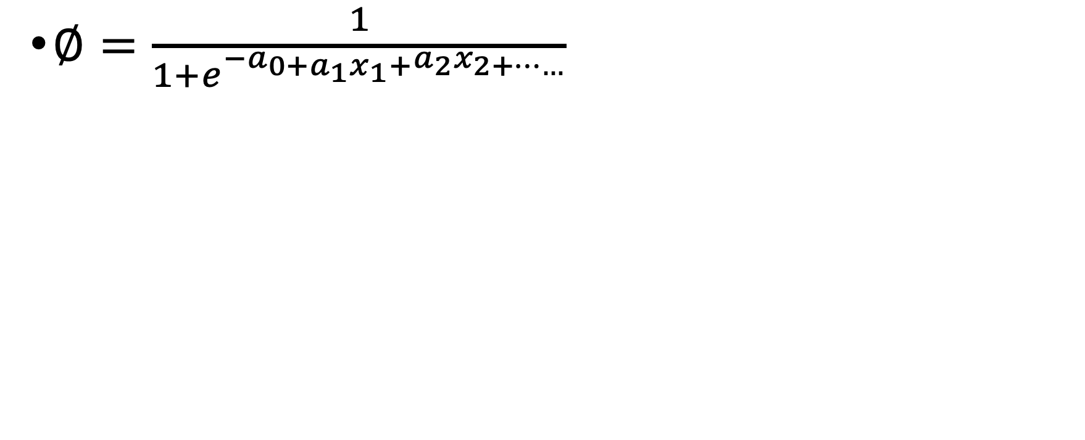
How to obtain the parameters in the model function?
$∅=\frac{1}{1+e^{−a_{0+a_{1}x_{1}+}a_{2}x_{2+……}}}$

Slide 16
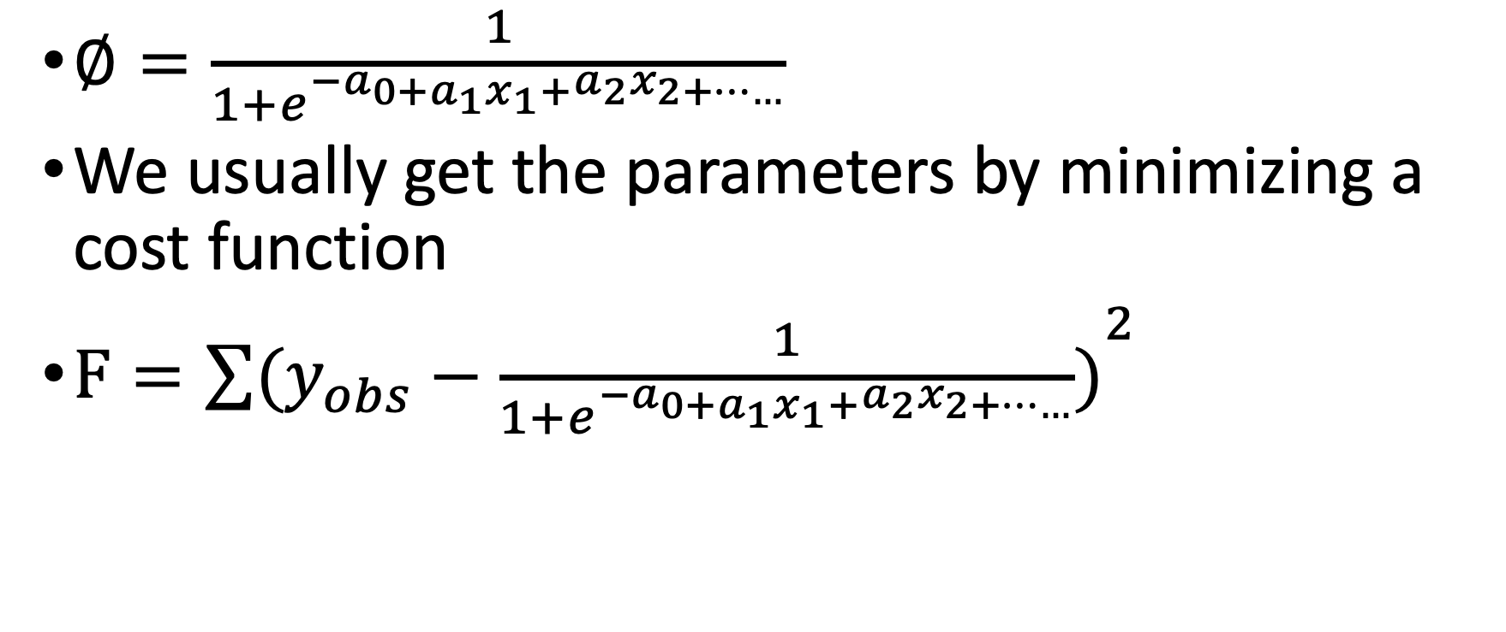
How to obtain the parameters in the model function?
$∅=\frac{1}{1+e^{−a_{0+a_{1}x_{1}+}a_{2}x_{2+……}}}$
We usually get the parameters by minimizing a cost function
$F={\sum{(y_{obs}−\frac{1}{1+e^{−a_{0+a_{1}x_{1}+}a_{2}x_{2+……}}})}}^{2}$

Slide 17
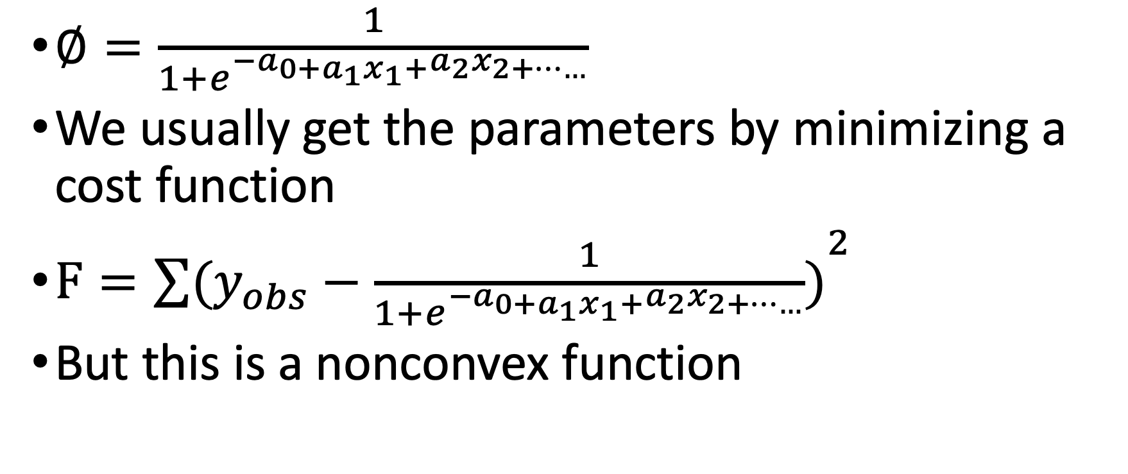
How to obtain the parameters in the model function?
$∅=\frac{1}{1+e^{−a_{0+a_{1}x_{1}+}a_{2}x_{2+……}}}$
We usually get the parameters by minimizing a cost function
$F={\sum{(y_{obs}−\frac{1}{1+e^{−a_{0+a_{1}x_{1}+}a_{2}x_{2+……}}})}}^{2}$
But this is a nonconvex function

Slide 18
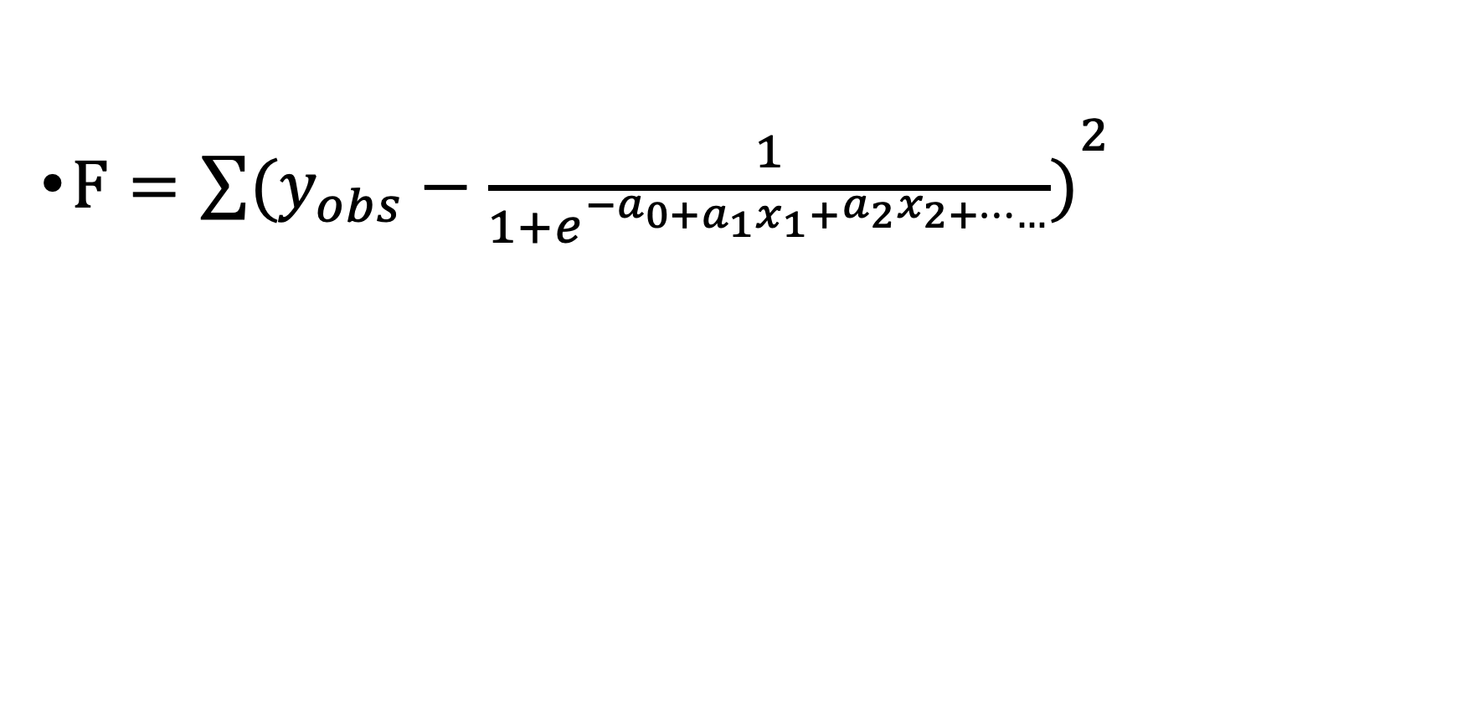
$F={\sum{(y_{obs}−\frac{1}{1+e^{−a_{0+a_{1}x_{1}+}a_{2}x_{2+……}}})}}^{2}$

Slide 19
How to convert our cost function to a convex function?

Slide 20
How to convert our cost function to a convex function?
https://www.internalpointers.com/post/cost-function-logistic-regression

Slide 21
How to convert our cost function to a convex function?
https://www.internalpointers.com/post/cost-function-logistic-regression

Slide 22
How to convert our cost function to a convex function?
https://www.internalpointers.com/post/cost-function-logistic-regression

